Slide 1
🐶 😻 Detector Convolutional Neural Networks
Kadar Amek
Joseph Filla
William Wright

Slide 2
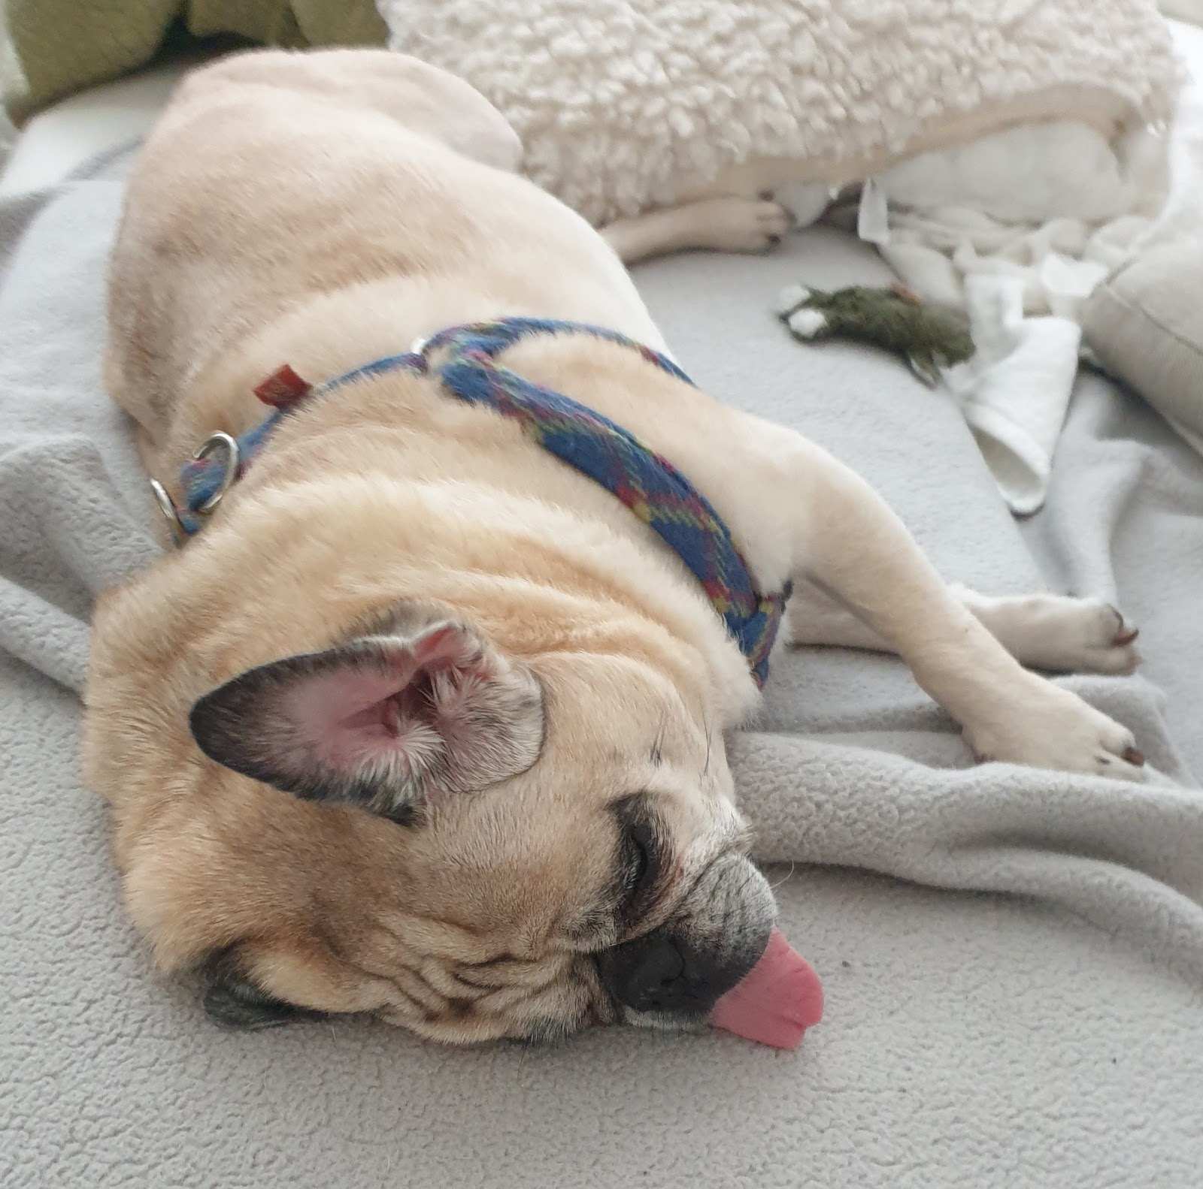
Is this a dog or a cat?

Slide 3




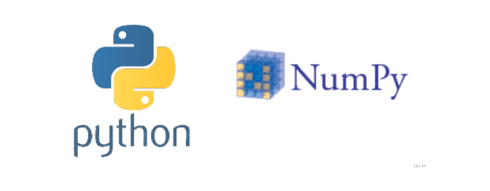


Libraries
25k 🐶😻
Notes:
modules/apps/data/notebooks we have used:
Dataset: contains 25,000 images of dogs and cats
Flask for UI to upload image
colab notebook to write and execute python code
matplotlib for viz
keras
chart.js for ui to display output data probability

Slide 4
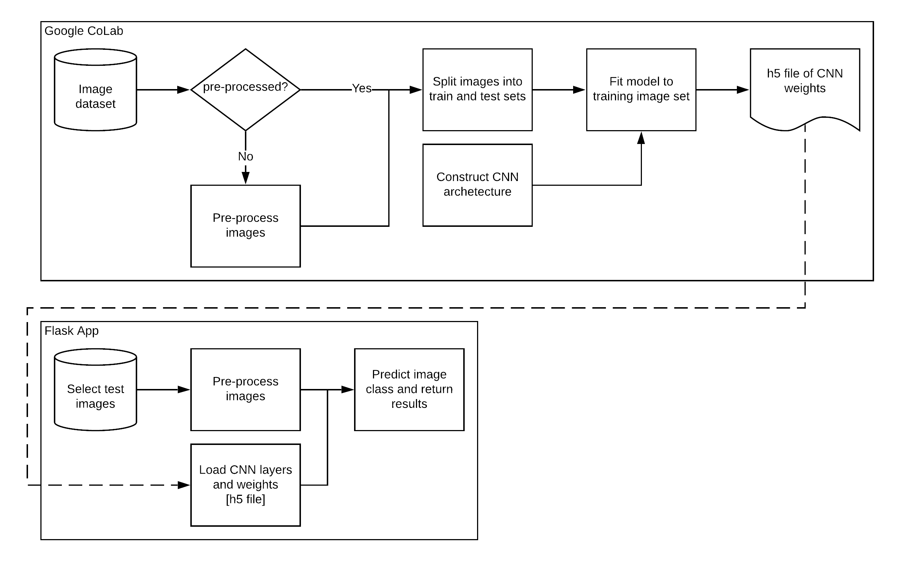
Roadmap
Notes:
before dive in, high-level overview

Slide 5
First stop … Let’s preprocess our data!

Slide 6
Roadmap

Slide 7
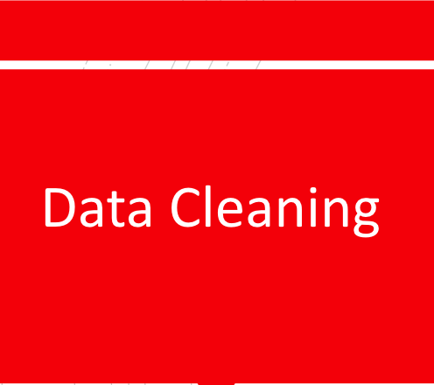
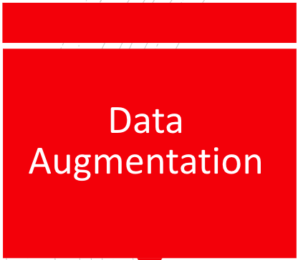
Real life is imperfect & messy so is our data!

Slide 8
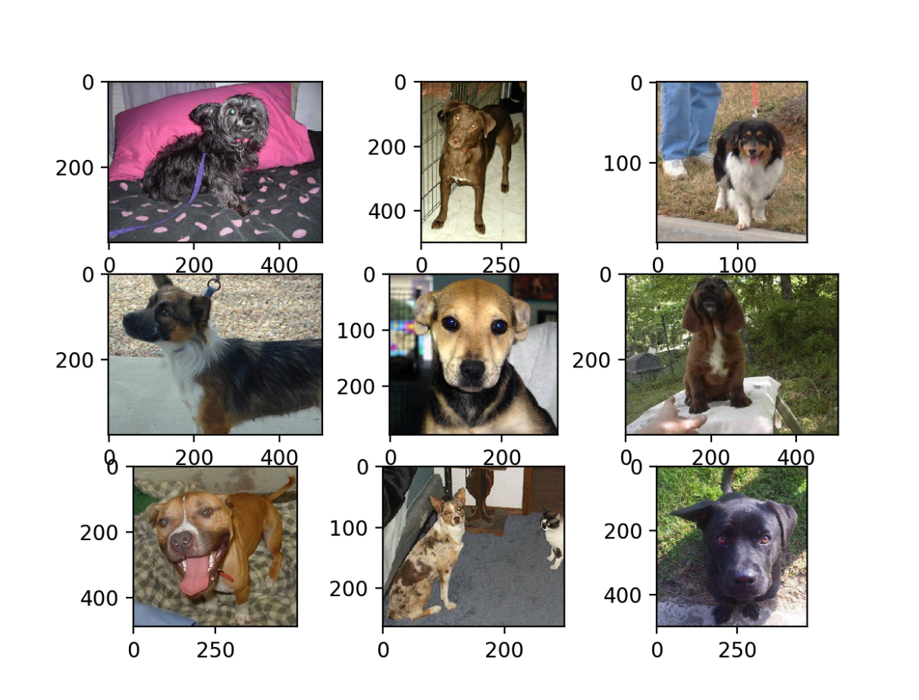
Unlike real life, training data must be perfect to be considered reliably beautiful!
Uniform Images
via batch resizing

Slide 9
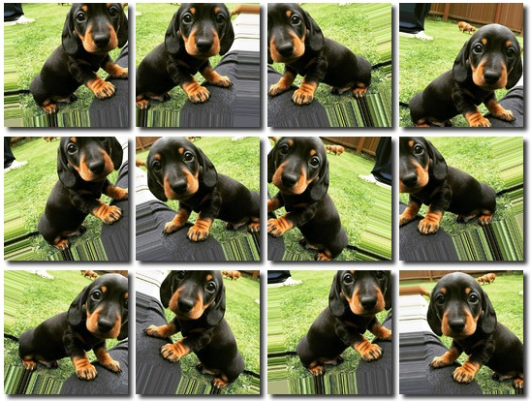
How do I get more data, if I don’t have more data?
And, why should I care?

Slide 10
Let’s Train … And Validate our Keras CNN model!
Notes:
this is for Will

Slide 11
Roadmap
Notes:
@Will no need for this slide as part of it has been already discussed (see slide 6-8)
regarding flask app structure, this will be discussed in Joe section
regarding image splitting: does not apply to our project since we used storage.googleapis so the data was already split
I’d suggest to dive straight to the CNN model on this slide

Slide 12
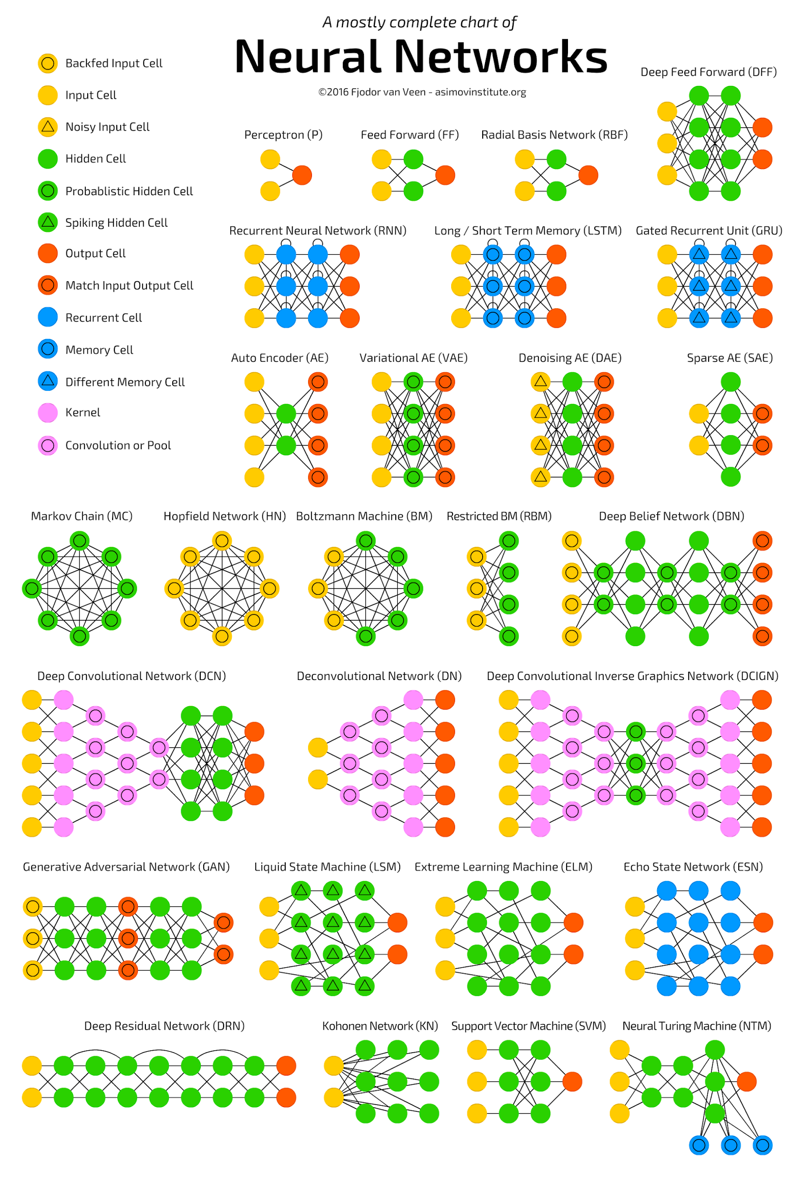
Convolutional Neural Networks
[CNN]
Notes:
now since our data has been preprocessed, let’s train our CNN model

Slide 13
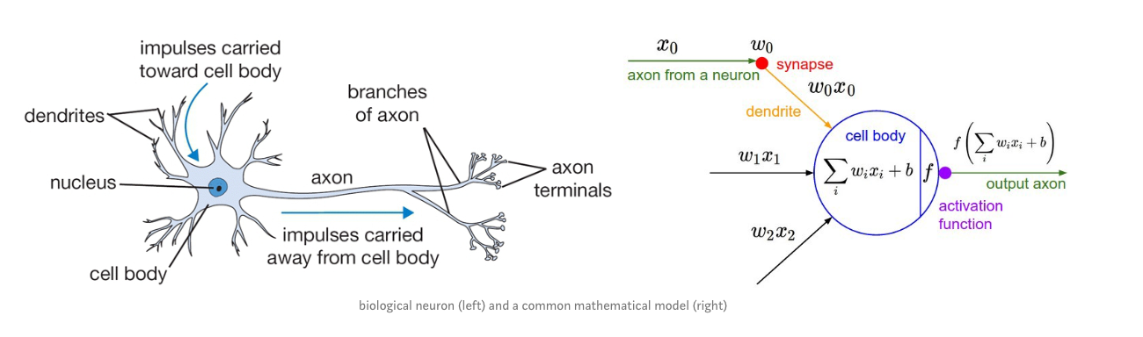
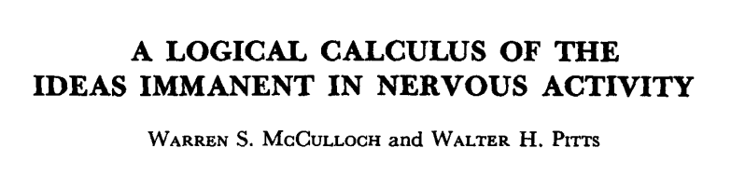
Neural Network
Notes:
google

Slide 14

Neural Network
Notes:
published in 1943

Slide 15

Convolution
Notes:
google

Slide 16
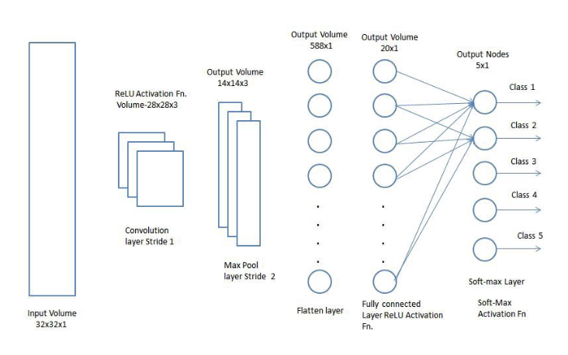
Convolutional Neural Networks
Notes:
google

Slide 17
drumroll, please….
Let’s Demo…Woof … Meow!

Slide 18
Roadmap
Notes:
@Will no need for this slide as part of it has been already discussed (see slide 6-8)
regarding flask app structure, this will be discussed in Joe section
regarding image splitting: does not apply to our project since we used storage.googleapis so the data was already split
I’d suggest to dive straight to the CNN model on this slide

Slide 19
End

Slide 20
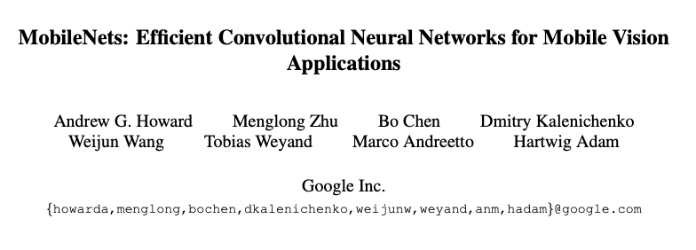
Base Model
MobileNets
Lean CNN meant to function on mobile devices
Developed by Google team in 2017
https://arxiv.org/pdf/1704.04861.pdf%EF%BC%89
Notes:
google

Slide 21
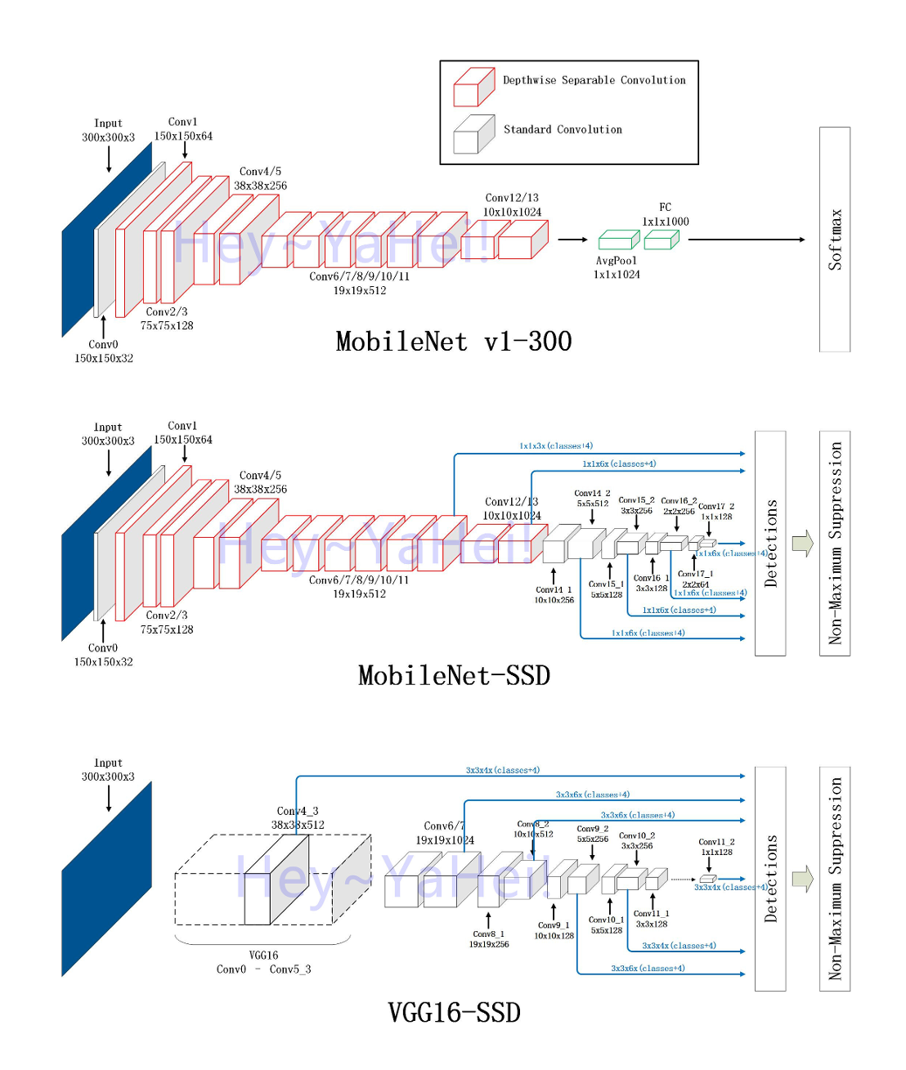
Base Model
Notes:
implementation
more details

Slide 22
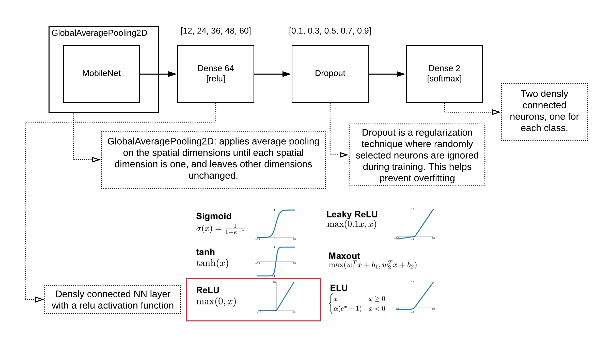
Our Model
Notes:
what does dense mean
what is droput?

Slide 23
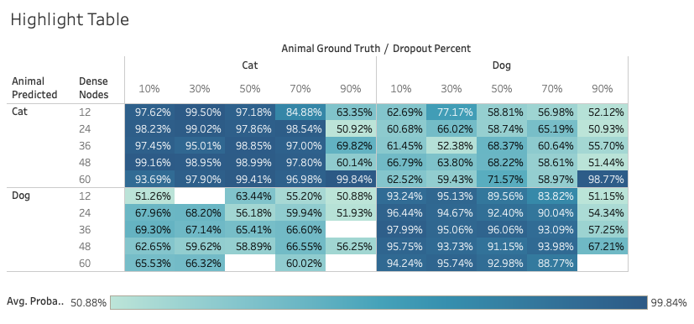
Our Model -- Solution Space
Notes:
e.g.,

